Slide 1
HG00-HG00 with Waists Centered at Half-plane PD
1st and 2nd Order Approximations in Shift and Tilt

Slide 2
Motivations
Refine 1st order results
Observe behavior of higher-order approximation
Identify valid domain of parameters (i.e., shift and tilt terms)
Check against Alex’s generalized solution
Validate 1st order approximations for other beam profiles and COR’s

Slide 3

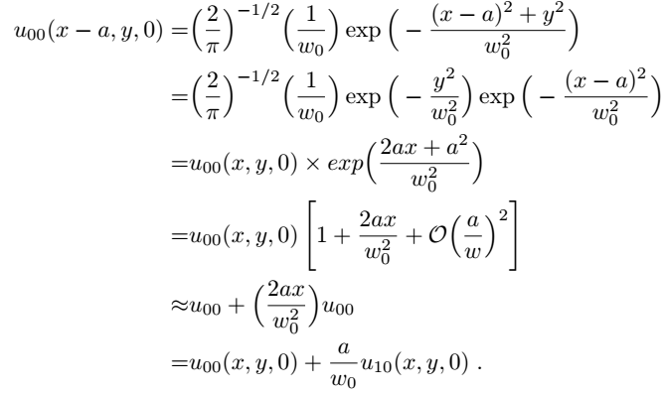
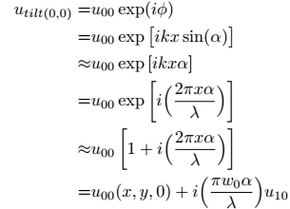
1st order Approximations
3
Shift:
Tilt:

Slide 4
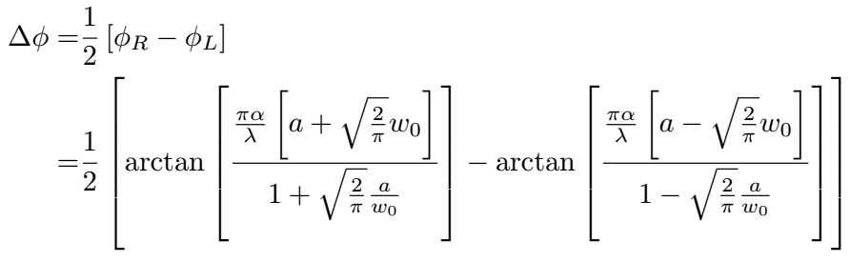
1st order DWS
4

Slide 5
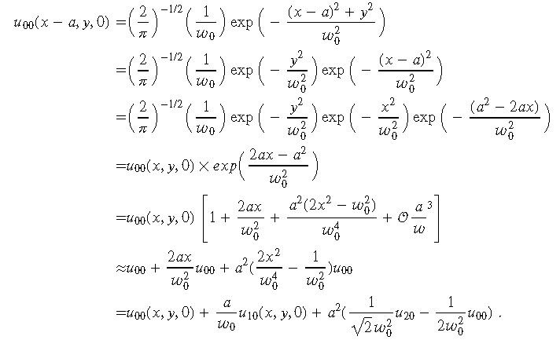
2nd order Approximation in Shift
5

Slide 6
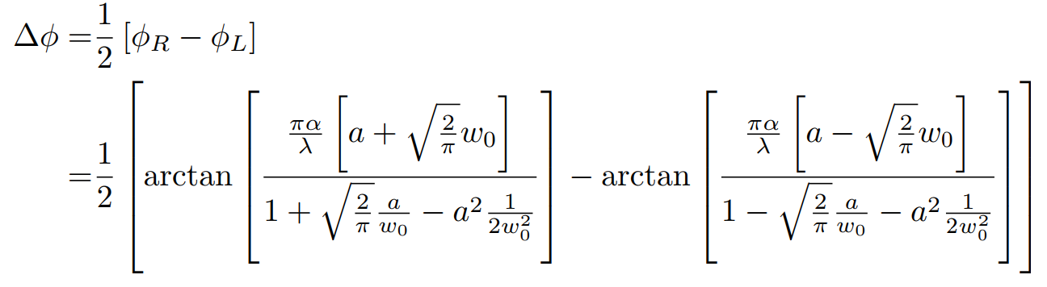
2nd order shift DWS
6

Slide 7
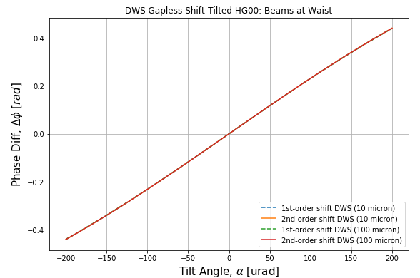
DWS (1st and 2nd order shift=10,100 micron)

Slide 8
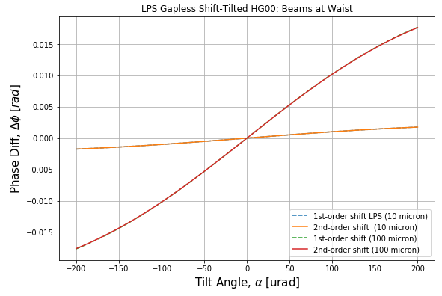
LPS (1st and 2nd order shift=10,100 micron)

Slide 9
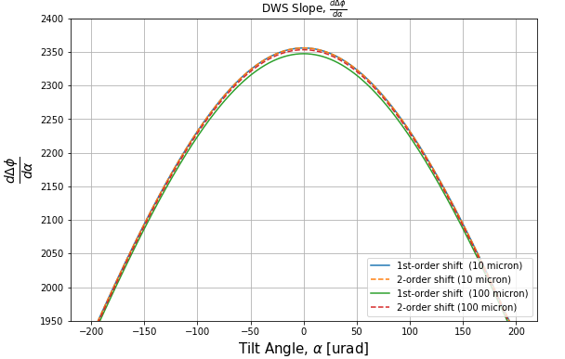

Slide 10
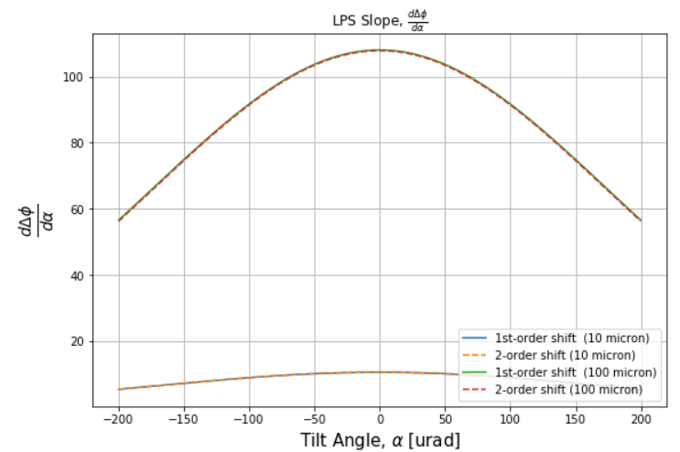

Slide 11
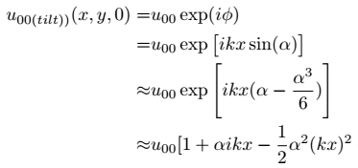
2nd order Approximation in Tilt
11

Slide 12
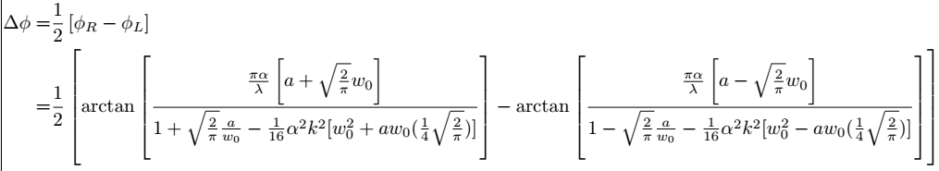
2nd order Tilt DWS
12

Slide 13
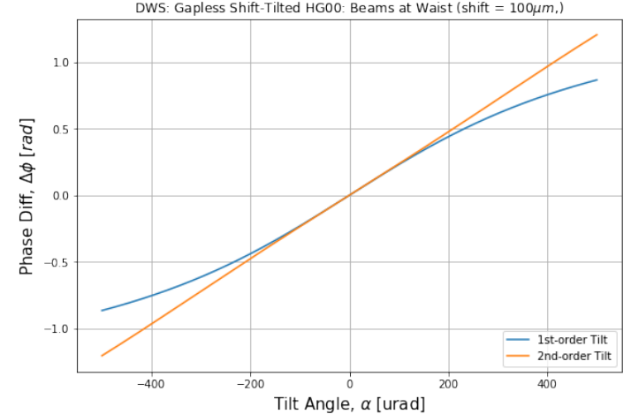

Slide 14
